Slide 1

Writing a “Good Enough” Session Submission
Louis Davidson
Nerd

Slide 2

It is simple to describe
Full head of hair before joining a Selection Committee… Yanked out one strand at a time
Write the most entertaining, compelling, focused, descriptive abstract possible
Don’t be annoying or offensive to anyone who may read it
Even beyond the obvious –isms to avoid
Less simple to do, naturally

Slide 3

Find a Pattern that Works
Story
What you will cover
Who should attend
What will attendees get
The strawberry pattern does NOT works!

Slide 4

My Best Tip For You
Read your submission 20+ times
With enough readings, you will know how a selection committee member feels
The next slides are things to do

Slide 5
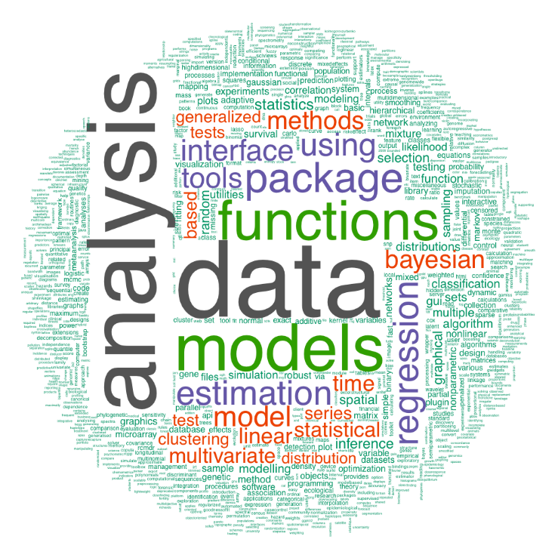
Keep It Concise
Bottom line: You are trying to summarize what you will present at a high level, not the narration to the presentation.

Slide 6

Mind the Clock
Make the abstract match the session time
A five minute session with 3 long paragraphs is probably too much
A five hour session with 1 sentence (of any length) is almost certainly too little

Slide 7
Don’t Be Repetitive
Don’t Be Repetitive
Don’t Be Repetitive
Don’t Be Repetitive
Don’t Be Repetitive
Don’t Be Repetitive
Don’t…

Slide 8
Really, these start to stand out quick
In this session, you will learn ___________. And you will learn ___________. And you will learn ___________. And you will learn ___________. And you will learn ___________. And you will learn ___________.
Bottom line: learn about the <shift>-<f7> keystroke sequence in Word, Excel, One Note, etc. and don't be repetitive, don't be repetitive, and shift-f7, m’kay?

Slide 9
Make the Content of the Title Match The Abstract
Using SQL Server Replication
Microsoft introduced Mirroring to SQL Server as a way to create replicas of your data…Replication is another way to… SSIS can also be utilized… SELECT INTO…
Better Title: Providing Replicas of Your SQL Server Data
100 Ways to Improve Your SQL Server Queries
Notification Services is a feature that will let you…
Bonus: It is also good if your abstract covers topics that are interesting to people

Slide 10

If You Start a Theme, Stick With It
Write Queries like Superman Queries are easy to write. All you need to know is..
Easy Query Writing Look. Up in the sky, it's a bird, it's a plane, it-Super Query Writer. Code faster than a speeding train, return more data than skyscraper full of filing cabinets..
Write Queries like Superman Look. Up in the sky, it's a bird, it's a plane, it-Super Query Writer. Code faster than a speeding train, return more data than skyscraper full of filing cabinets..
Easy Query Writing Queries are easy to write. All you need to know is..
Bonus: A boring abstract is not bad, but a confusing one is.

Slide 11

Moderate Self-aggrandizing and Self-deprecation
In this session, the greatest speaker ever will give you an incredibly deep look at a topic that he has been doing since the beginning of time better than you.
Bonus: The bio is the place for bragging about yourself!

Slide 12
Wetch Out Four Type O’s and Speeling
Baking Cookies
Beeking COoky
The best way to bake excellent cookies is to use a clothes iron
Form the dough into round balls
Heat the iron to 375 degrees and press the cookies individually 13 seconds each
When the dough stops sticking to the iron they are brown
The best weigh to baak cokies is to use a heaterd convertion ovin
Form thee doo into balls that are ground in shEep
Heet the ovin to 375
Put the bells onto a sheep that has been gREesed
Cook on the sheep for 20 min nuts until the colur of dirt
Clearly the best recipe of the two

Slide 13

Bottom Line
Don’t let the abstract get in the way of your awesome ideas

Slide 14
Resources
Because you need more than this short session
These slides are downloadable from:
http://www.drsql.org/Pages/Presentations.aspx
Some great reading
PASS Speaker Resource Page
http://www.sqlpass.org/Community/SpeakerResource.aspx
Tips for submitting a PASS Summit Abstract
http://www.sqlpass.org/Default.aspx?TabId=223
Adam Machanic’s awesome Blog on Session Submissions
http://sqlblog.com/blogs/adam_machanic/archive/2013/02/22/capturing-attention-writing-great-session-descriptions.aspx

Slide 15

Contact info
Notes:
[twitter] Slides will be on drsql.org in the presentations area for this and the keynote as soon as I can get them out there. @rmtechtrifecta [/twitter]

